Slide 1
Analytical App Development
Adrian Streitz, Johannes Rank, Borys Levkovskyi

Slide 2
Prerequisites
Fundamental programming skills
Completion of the module SAPUI5
Completion of the module OData
Recommended: Completion of the module SAP Fiori

Slide 3
Agenda
Motivation
UI Controls for Simple Charts
Chart Container
Chart Types
Smart UI Controls
Mockservers

Slide 4
I. Motivation
Dashboards represent a common way of information visualization
Cover aggregated information needed usually by middle and upper management
Involve real-time data (KPIs, sensor data, …)
Roll-up and drill-down functionality as must-have for multidimensional data (e.g. sales orders)

Slide 5
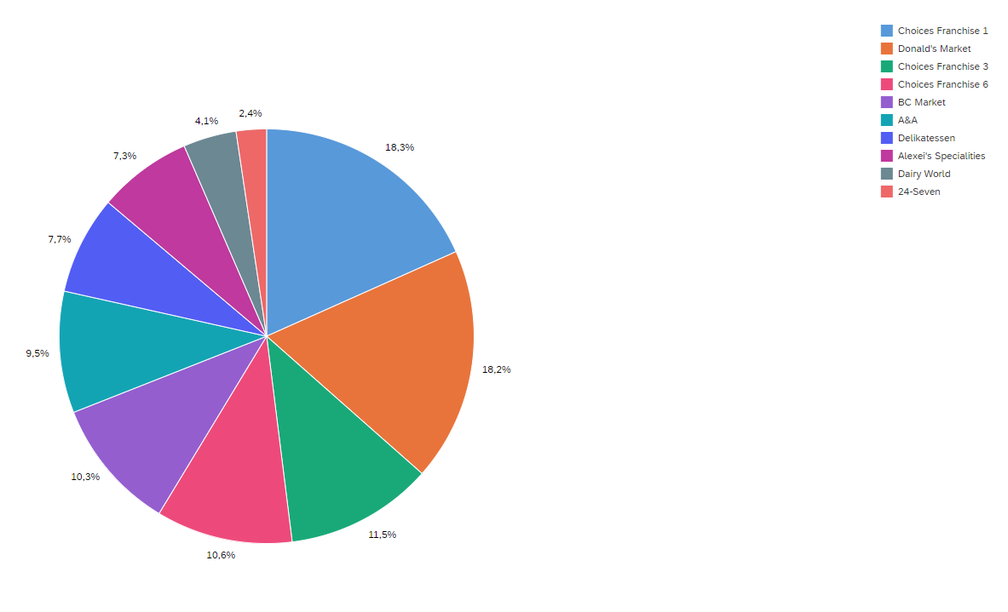
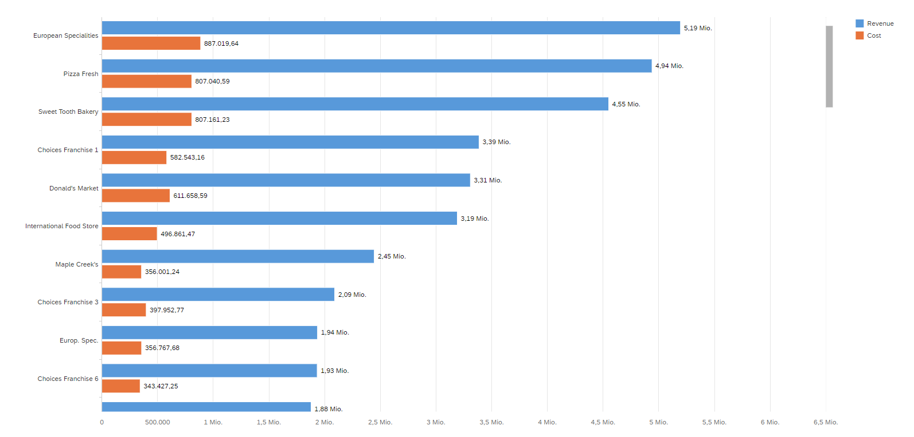
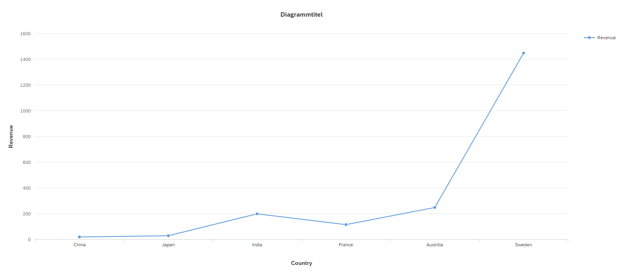
II. UI Controls for Simple Charts Viz-Library Charts
Displays data from data models
(JSON or OData)
Supports different chart types:
line, column, pie, heatmap…
Simple implementation – minimal need for frontend programming if data arrives in a correct form

Slide 6
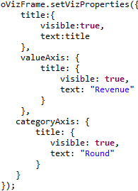
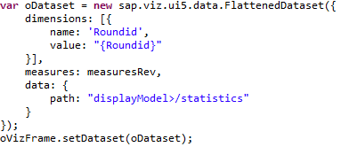


II. UI Controls for Simple Charts Viz-Library Charts – API
setVizProperties() – configures texts for title, category axis, and value axis
setDataset() – performs data binding, requires a special Object, FlattenedDataset, as a parameter
addFeed() – ads a feed to a chart. AxisLabels and PrimaryValues are mandatory.

Slide 7
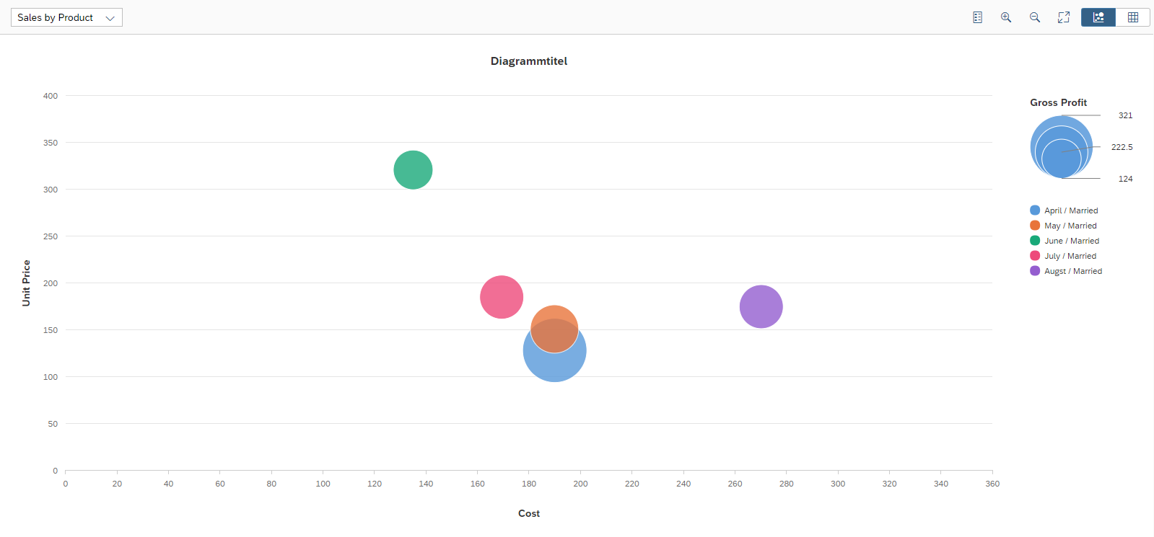
II. UI Controls for Simple Charts Chart Container
Provides functions for direct interaction with the chart
Basic functions
zooming
enable/disable legend
full-screen mode
Extendable with customized buttons and other interface elements according to your needs
Charts need to be placed in the container

Slide 8
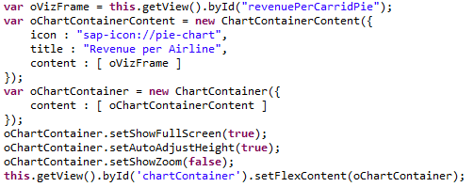
II. UI Controls for Simple Charts Chart Container – API
Instantiated via constructor
Constructor has an object of a type ChartContainerContent as a parameter
ChartContainerContent instantiated with icon (path), title (String), and content (array of chart objects)
Every standard container button has its own visibility setter
Is injected into another control (e.g. as FlexContent of a FixFlex)

Slide 9
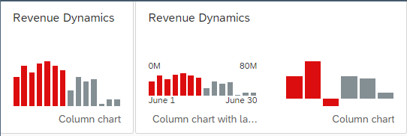
II. UI Controls for Simple Charts Micro Chart
Small layout size
Supports all usual chart types, like bar, column, pie, etc. *
Usually used to depict a single KPI
Integrable into Fiori Tiles
No interaction with single chart elements possible
however the chart as a whole may react to clicks (if not integrated into a tile)
* https://experience.sap.com/fiori-design-web/chart-types/

Slide 10
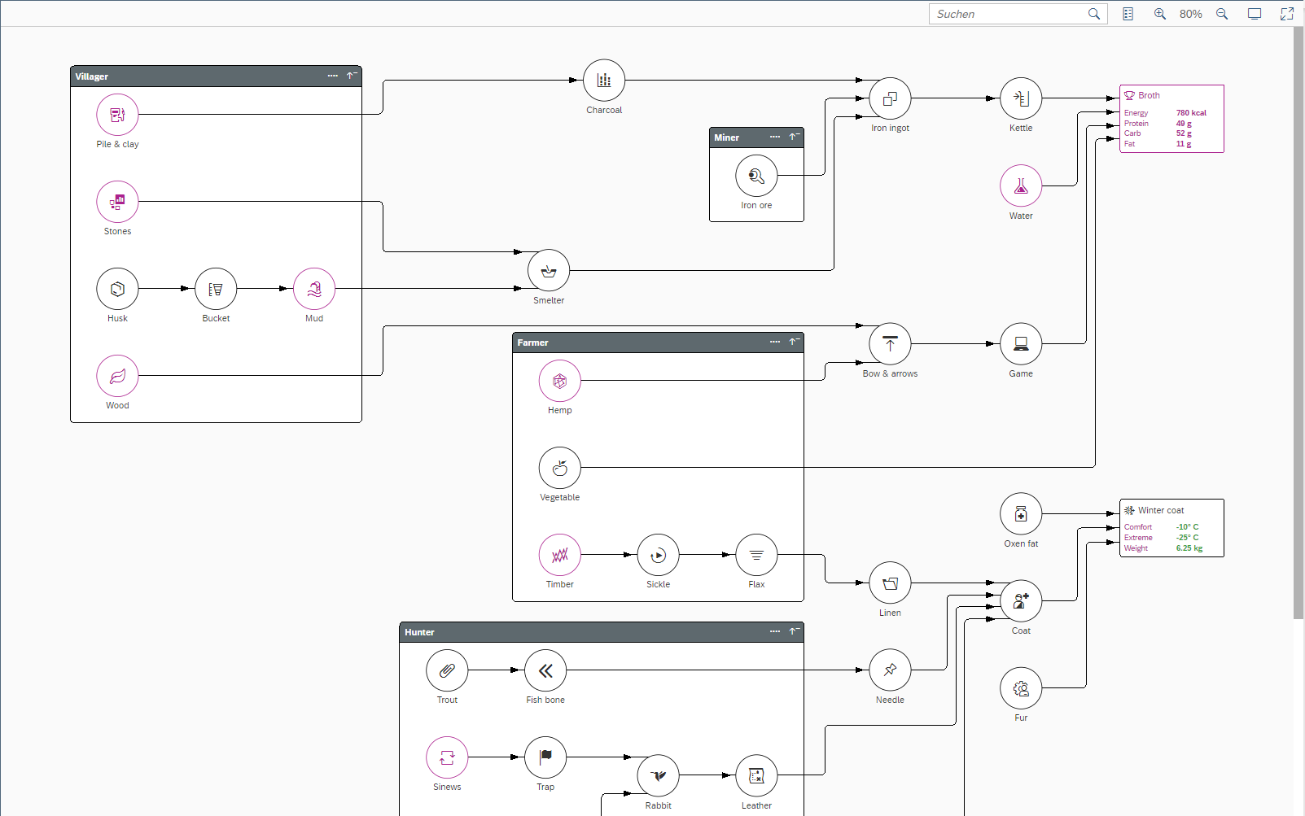
II. UI Controls for Simple Charts Network Graph
Structural illustration of nodes and connecting lines
Good example – workflow visualization (on the screenshot)
Entire layout design customizable
Child nodes can be expanded or collapsed
Group assignment of multiple nodes
Minimal frontend programming necessary

Slide 11
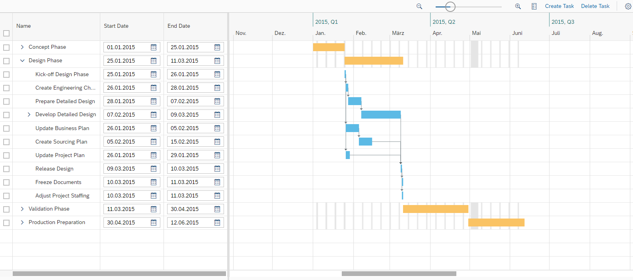
III. Smart UI Controls Gantt Chart
Illustration of a project plan (incl. milestones)
Bounded to a table and/or a tree map
Self-adapting chart according to expanded nodes of an underlying tree map
Very complex control
Requires high programming effort on the frontend side

Slide 12
Now you know the basics about the simple charts in UI5.
To consolidate your knowledge, you can do tasks 1 – 4 of the Analytical Apps Developemnt exercise.

Slide 13
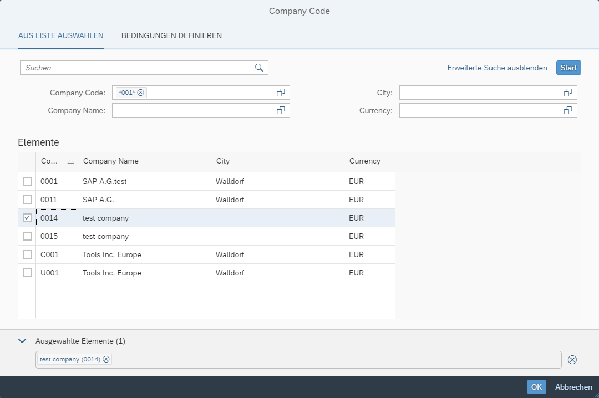
III. Smart UI Controls Smart Field / Smart Form
Extended input help (not just simple values, but various search possibilities)
Provides the user with the input help like he is used to when working with SAP GUI
Special case: currency fields
Currency that corresponds to a selected value (e.g. flight price) is loaded from the database without the necessity to select it manually
Usually grouped into smart forms

Slide 14
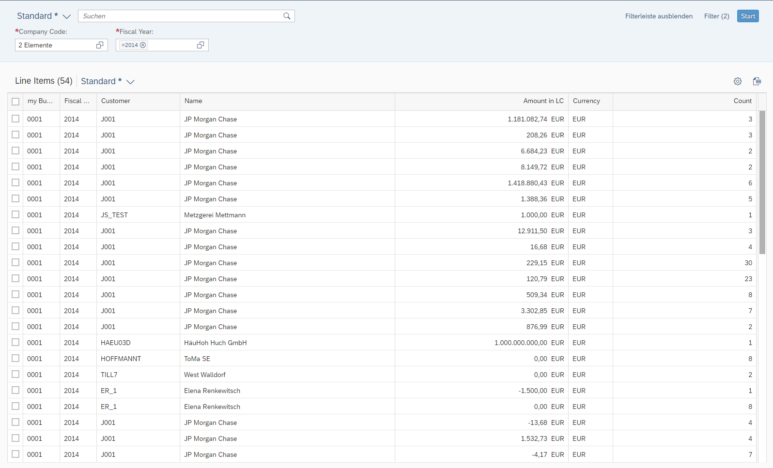
III. Smart UI Controls Smart Table
Illustrates data as table
Enables data sorting and filtering
Various customization possibilities (e.g. editable cells)
Allows creation of custom layouts (comparable with ALV grids)
Combinable with smart fields in header

Slide 15
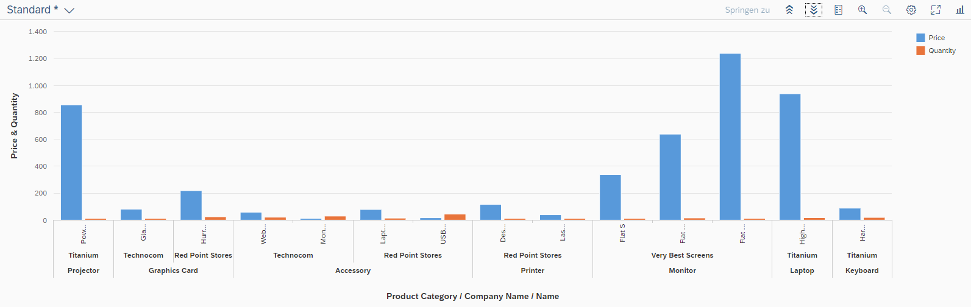
III. Smart UI Controls Smart Chart
Extends functions of normal chart UI elements
No chart container necessary
toolbar available by default
Multiple interactions available without further configuration
navigation based on graph elements
graph types changeable at runtime
data roll-up/drill-down
layout configuration (e.g. chart legend)

Slide 16
Now you know the basics about the simple charts in UI5.
To consolidate your knowledge, you can do tasks 5 – 7 of the Analytical Apps Developemnt exercise.

Slide 17
Check your knowledge

Slide 18
Check your knowledge
Is it always necessary to place a chart within a chart container?In which cases is a semantic object needed?
Why do we need analytical apps?

Slide 19
Solution

Slide 20
Solution
Is it always necessary to place a chart within a chart container?In which cases is a semantic object needed?
→ No, it is not. SmartCharts have their own toolbar, and the viz-Charts can be depicted without the container. It just allows more interaction with the chart.
Why do we need analytical apps?
→ Slide 4

